Slide 1
Introduction to Transaction Processing Concepts
Dr. S. RENUKA DEVI
Associate Professor
SCSE
VIT Chennai Campus

Slide 2
What is Transaction Processing System?
Systems with large databases and hundreds of concurrent users executing database transactions
Examples of such systems include airline reservations, banking, credit card processing, online retail purchasing, stock markets, supermarket checkouts
These systems require high availability and fast response time for hundreds of concurrent users
Transaction represents a logical unit of database processing that must be completed in its entirety to ensure correctness
A transaction is typically implemented by a computer program, which includes database commands such as retrievals, insertions, deletions, and updates

Slide 3
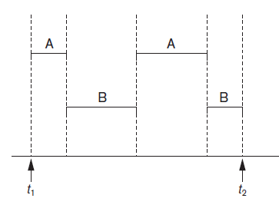
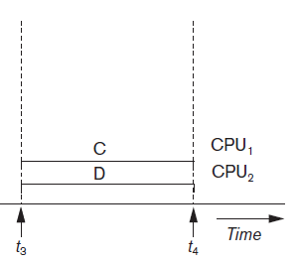
Concurrent Transactions
Interleaved processing versus parallel processing of concurrent transactions

Slide 4
Concurrent Transactions (Contd…)
Interleaving keeps the CPU busy when a process requires an input or output (I/O) operation, such as reading a block from disk. The CPU is switched to execute another process rather than remaining idle during I/O time
If the computer system has multiple hardware processors (CPUs), parallel processing of multiple processes is possible

Slide 5
Transactions
A transaction is an executing program that forms a logical unit of database processing
A transaction includes one or more database access operations which include insertion, deletion, modification, or retrieval operations
The transaction can either be embedded within an application program or they can be specified interactively via a high-level query language such as SQL
One way of specifying the transaction boundaries is by specifying explicit begin transaction and end transaction statements in an application program
If the database operations in a transaction do not update the database but only retrieve data, the transaction is called a read-only transaction; otherwise it is known as a read-write transaction

Slide 6
Transactions (contd…)
The basic database access operations that a transaction can include are as follows:
read_item(X) - Reads a database item named X into a program variable
write_item(X) - Writes the value of program variable X into the database item named X
Concurrency control and recovery mechanisms are mainly concerned with the database commands in a transaction

Slide 7
Why Concurrency Control Is Needed?
Several problems can occur when concurrent transactions execute in an uncontrolled manner
The Lost Update Problem. This problem occurs when two transactions that access the same database items have their operations interleaved in a way that makes the value of some database items incorrect
The Temporary Update (or Dirty Read) Problem. This problem occurs when one transaction updates a database item and then the transaction fails for some reason. Meanwhile, the updated item is accessed (read) by another transaction before it is changed back to its original value

Slide 8
Why Concurrency Control Is Needed?
The Incorrect Summary Problem. If one transaction is calculating an aggregate summary function on a number of database items while other transactions are updating some of these items, the aggregate function may calculate some values before they are updated and others after they are updated
The Unrepeatable Read Problem. Another problem that may occur is called unrepeatable read, where a transaction T reads the same item twice and the item is changed by another transaction T between the two reads

Slide 9
Why Recovery Is Needed?
If a transaction fails after executing some of its operations but before executing all of them, the operations already executed must be undone and have no lasting effect

Slide 10
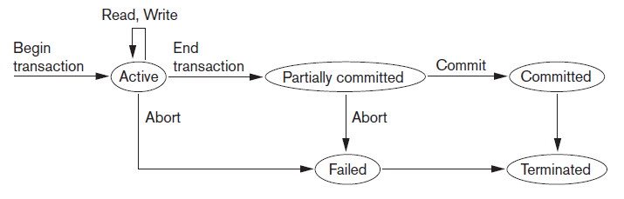
Transaction States

Slide 11
System Log
To recover from failures, the system maintains a log to keep track of all transaction operations
The log is a sequential, append-only file that is kept on disk
The following are the types of entries, called log records that are written to the log file
[start_transaction, T] - Indicates that transaction T has started execution.
[write_item, T, X, old_value, new_value] - Indicates that transaction T has changed the value of database item X from old_value to new_value.
[read_item, T, X] - Indicates that transaction T has read the value of database item X.
[commit, T] - Indicates that transaction T has completed successfully, and affirms that its effect can be committed (recorded permanently) to the database.
[abort, T] - Indicates that transaction T has been aborted.

Slide 12
Commit Point of a Transaction
A transaction T reaches its commit point when all its operations that access the database have been executed successfully and the effect of all the transaction operations on the database have been recorded in the log.
Beyond the commit point, the transaction is said to be committed, and its effect must be permanently recorded in the database.
The transaction then writes a commit record [commit, T] into the log.
If a system failure occurs, we can search back in the log for all transactions T that have written a [start_transaction, T] record into the log but have not written their [commit, T] record yet; these transactions may have to be rolled back to undo their effect on the database during the recovery process.

Slide 13
Desirable Properties of Transactions
Transactions should possess the following properties, often called the ACID properties;
Atomicity – A transaction should either be performed in its entirety or not performed at all
Consistency preservation - A transaction should be consistency preserving, meaning that if it is completely executed from beginning to end without interference from other transactions, it should take the database from one consistent state to another
Isolation - A transaction should appear as though it is being executed in isolation from other transactions, even though many transactions are executing concurrently
Durability or permanency - The changes applied to the database by a committed transaction must persist in the database. These changes must not be lost because of any failure.

Slide 14
Schedules of Transactions
When transactions are executing concurrently in an interleaved fashion, then the order of execution of operations from all the various transactions is known as a schedule (or history)
Operations from different transactions can be interleaved in the schedule S
Two operations in a schedule are said to conflict if they satisfy all three of the following conditions:
(1) they belong to different transactions;
(2) they access the same item X
(3) at least one of the operations is a write_item(X)

Slide 15
Characterizing Schedules Based on Recoverability
Once a transaction T is committed, it should never be necessary to roll back T
The schedules that theoretically meet this criterion are called recoverable schedules; otherwise they are called non-recoverable schedules
It is possible for a phenomenon known as cascading rollback (or cascading abort) to occur in some recoverable schedules
Cascading rollback can be quite time-consuming
A schedule is said to be cascadeless, if every transaction in the schedule reads only items that were written by committed transactions
Strict schedule – schedule in which transactions can neither read nor write an item X until the last transaction that wrote X has committed (or aborted)

Slide 16
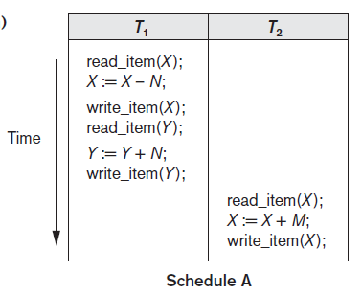
Characterizing Schedules Based on Serializability
Serializable schedules – type of schedules that are always considered to be correct when concurrent transactions are executing
Example 1: Serial schedule A: T1 followed by T2

Slide 17
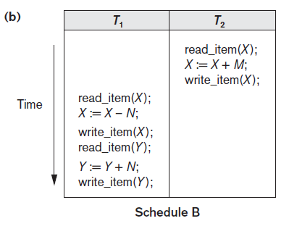
Serializable Schedules
Example: Serial schedule A: T2 followed by T1

Slide 18
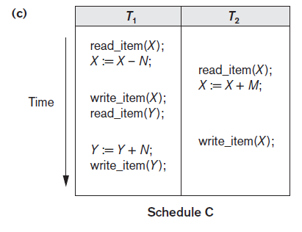
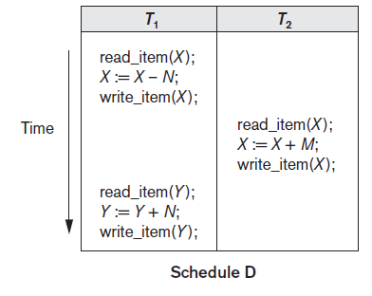
Nonserial schedules C and D with interleaving of operations

Slide 19
Serial, Nonserial, and Conflict-Serializable Schedules
The concept of serializability of schedules is used to identify which schedules are correct when transaction executions have interleaving of their operations in the schedules.
A schedule S is serial if, for every transaction T participating in the schedule, all the operations of T are executed consecutively in the schedule; otherwise, the schedule is called nonserial
No interleaving occurs in a serial schedule.
The problem with serial schedules is that they limit concurrency by prohibiting interleaving of operations. Serial schedules are considered unacceptable in practice.
A schedule S of n transactions is serializable if it is equivalent to some serial schedule of the same n transactions.
Two schedules are called result equivalent if they produce the same final state of the database
we define a schedule S to be conflict serializable if it is (conflict) equivalent to some serial schedule S

Slide 20
Testing for Conflict Serializability of a Schedule
Algorithm
For each transaction Ti participating in schedule S, create a node labeled Ti in the precedence graph.
For each case in S where Tj executes a read_item(X) after Ti executes a write_item(X), create an edge (Ti→ Tj) in the precedence graph.
For each case in S where Tj executes a write_item(X) after Ti executes a read_item(X), create an edge (Ti→Tj) in the precedence graph.
For each case in S where Tj executes a write_item(X) after Ti executes a write_item(X), create an edge (Ti→ Tj) in the precedence graph.
The schedule S is serializable if and only if the precedence graph has no cycles.

Slide 21
Conflict Serializability
The precedence graph is constructed as described in the Algorithm
If there is a cycle in the precedence graph, schedule S is not (conflict) serializable; if there is no cycle, S is serializable
If there is no cycle in the precedence graph, we can create an equivalent serial schedule S that is equivalent to S, by ordering the transactions that participate in S as follows:
Whenever an edge exists in the precedence graph from Ti to Tj, Ti must appear before Tj in the equivalent serial schedule S.

Slide 22
Any Queries?

